Slide 1





Popular Used tools in data science field
In this presentaion will discuss about popuar tools
Vott – PoweBI

Slide 2

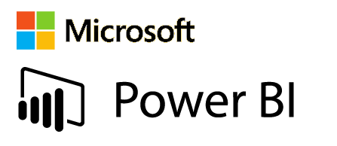
We will talk about 2 Data science tools in our presentation

Slide 3
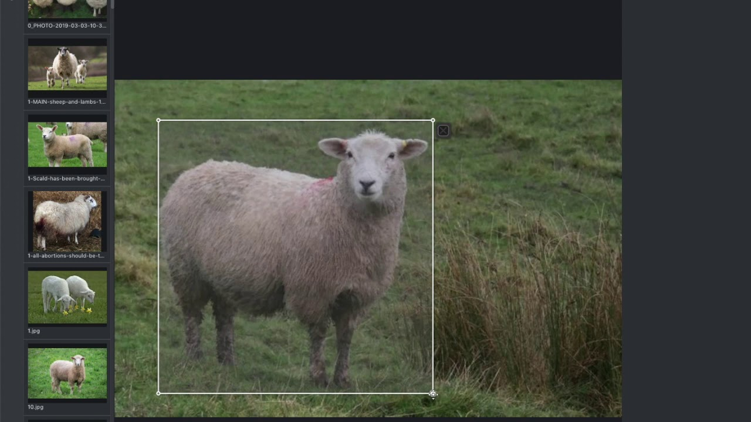
VoTT: Visual Object Tagging Tool
VoTT is a powerful tool for annotating and training models for computer vision tasks. Discover its features, setup process, annotation workflow, and more!

Slide 4
Features of VoTT
Intuitive Interface
Labeling Flexibility
VoTT provides a user-friendly interface, allowing users to efficiently annotate objects in images and videos.
With VoTT, you can create custom labels and define multiple object classes to suit your specific project needs.
Collaboration Tools
VoTT offers collaborative annotation features, enabling multiple team members to work on the same project simultaneously.

Slide 5
Annotation Workflow in VoTT
1
Create Project
2
Annotate Objects
Start by creating a new project in VoTT and specify the annotation parameters.
Use the annotation tools provided by VoTT to mark and label objects of interest accurately.
3
Review and Validate
4
Save and Export
Thoroughly review and validate the annotations to ensure accuracy and consistency.
Save and export the annotations in various formats compatible with popular machine learning frameworks.

Slide 6

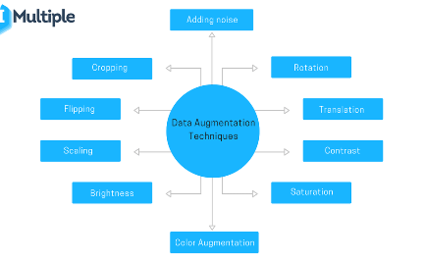
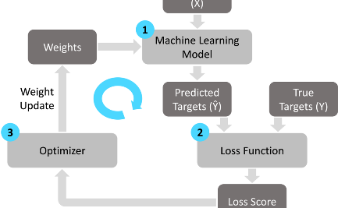
Training Models with VoTT
Model Configuration
Data Augmentation
Training Process
Configure and fine-tune your machine learning models using VoTT's flexible training options.
Apply data augmentation techniques to increase the diversity and size of your training dataset.
Monitor the training progress and adjust the model parameters to achieve optimal performance.

Slide 7
Exporting Annotations and Models from VoTT
1
Package Annotations
Combine and export annotations along with the original images to simplify data sharing and model deployment.
Export Trained Models
2
Export the trained models generated using VoTT to utilize them for inference and integration in various applications.
3
Supported Formats
VoTT supports popular formats like COCO, Pascal VOC, and TensorFlow Object Detection API for seamless integration.

Slide 8
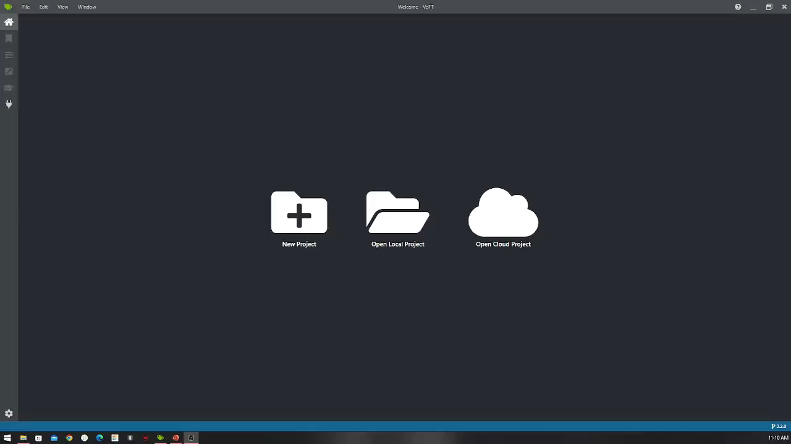

Slide 9
Power BI is a powerful business analytics tool developed by Microsoft that enables organizations to visualize their data and share insights across the enterprise.
As a cloud-based service,it provides a user-friendly interface for creating interactive reports, dashboards, and data visualizations.
Power BI empowers users to make informed decisions based on a comprehensive understanding of their data.

Slide 10
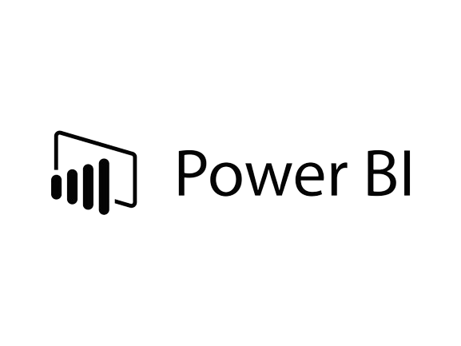
Some Usages Of
1.Data Visualization and Exploration
Power BI provides an intuitive interface for creating interactive charts and dashboards, simplifying the exploration and understanding of complex datasets.
2.Data Connectivity and Integration
With versatile data connectors, Power BI seamlessly integrates with various sources, allowing users to consolidate and analyse data from different platforms.
3.Real-Time Analytics
Power BI supports real-time data analytics, offering timely insights by monitoring and analyzing data as it is generated.
4.AI-Powered Insights
Leveraging Microsoft's AI, Power BI automates data analysis, helping users uncover meaningful insights without requiring advanced data science skills.
5.Collaboration and Sharing
Power BI facilitates secure sharing of reports and dashboards, promoting effective collaboration and communication of insights within teams and across the organization.
6.Mobile Accessibility
The Power BI mobile app ensures users can access reports and dashboards on-the-go, enhancing flexibility and enabling quick decision-making from any location.
7.Integration with Microsoft Office Tools
Seamless integration with Microsoft Office tools, such as Excel, streamlines workflows, allowing users to leverage familiar applications for data analysis.
8.Scalability and Enterprise Readiness
Designed for scalability, Power BI meets the growing data needs of enterprises, offering enterprise-grade features like robust security and compliance measures.

Slide 11
Advantages & disadvantages of
Advantages
Disadvantages
Intuitive Interface:
User-friendly design for easy adoption.
Versatile Connectivity:
Seamless integration with diverse data sources.
Real-Time Analytics:
Timely insights for agile decision-making.
AI-Driven Insights:
Automated analysis for meaningful conclusions.
Collaboration Features:
Enhances teamwork and effective communication.
Learning Curve:
Some users may face initial complexity.
Cost Implications:
Full features may incur subscription costs.
Microsoft Ecosystem Dependency:
Tightly integrated, potentially limiting flexibility.
Limited Offline Functionality:
Reduced capabilities without internet access.
Customization Complexity:
Advanced customization may require technical expertise.

Slide 12
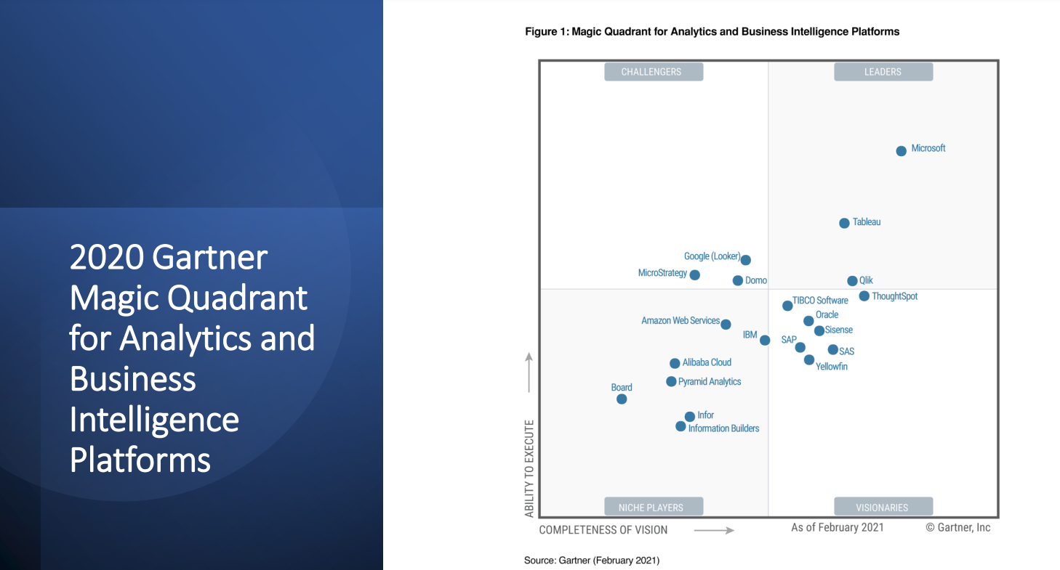

Slide 13
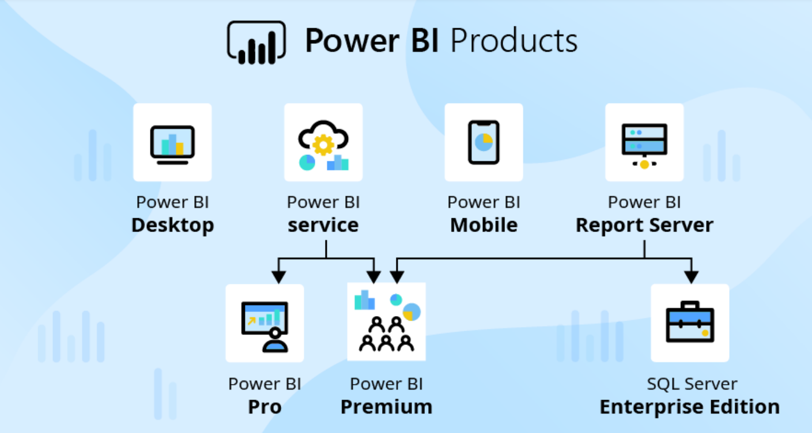

Slide 14
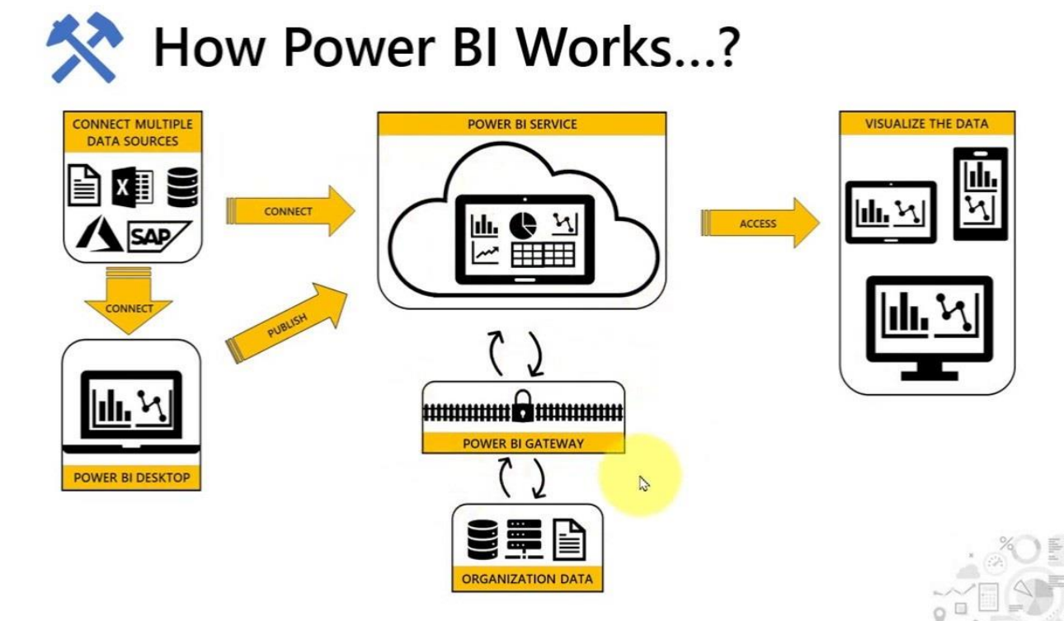

Slide 15
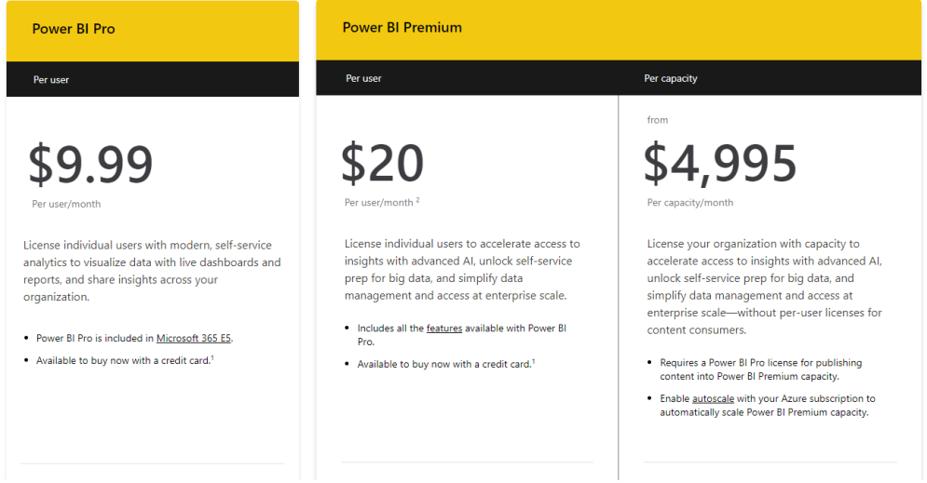
Power BI Prices

Slide 16
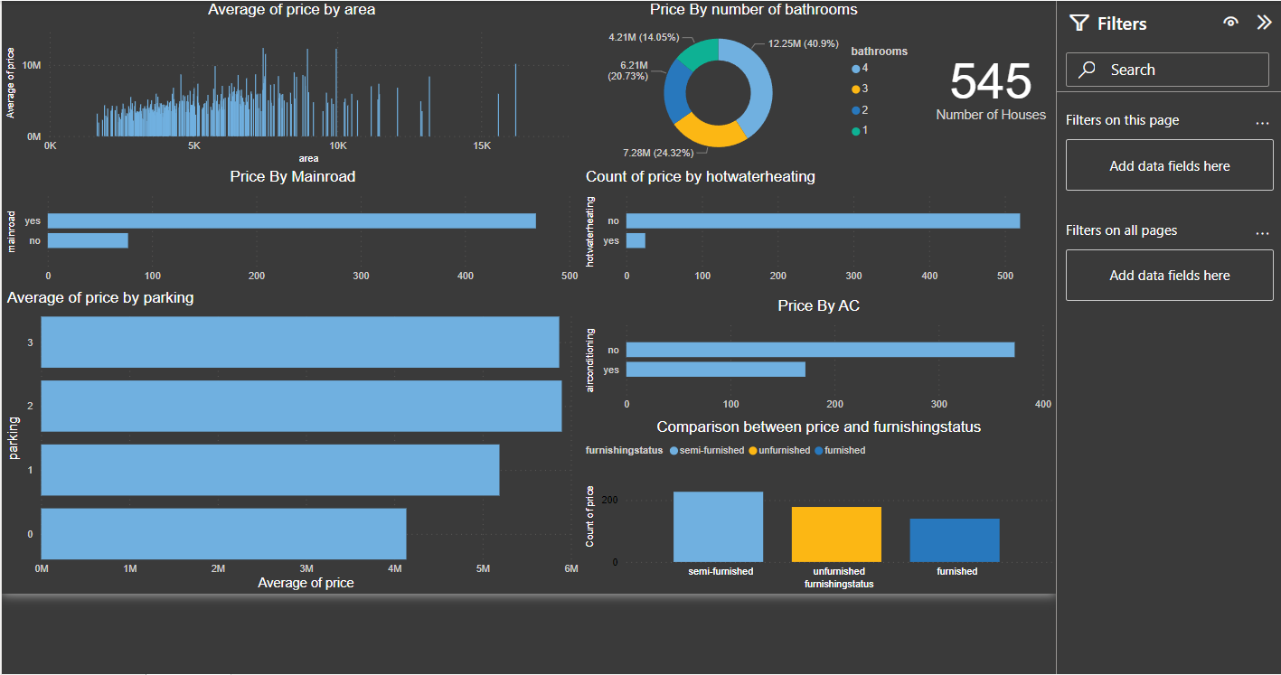
Power BI applied on a Housing price data

Slide 17
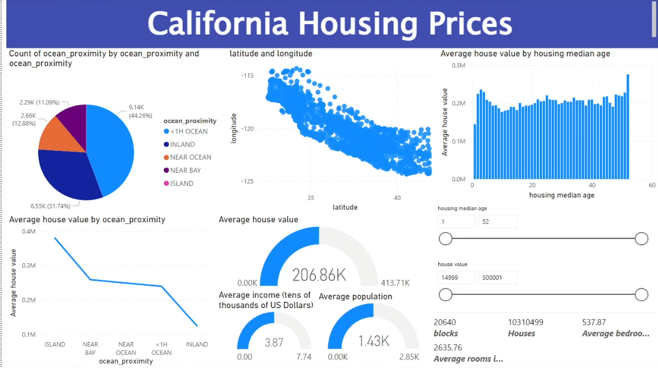
Power BI applied on a Housing price data 2

Slide 18
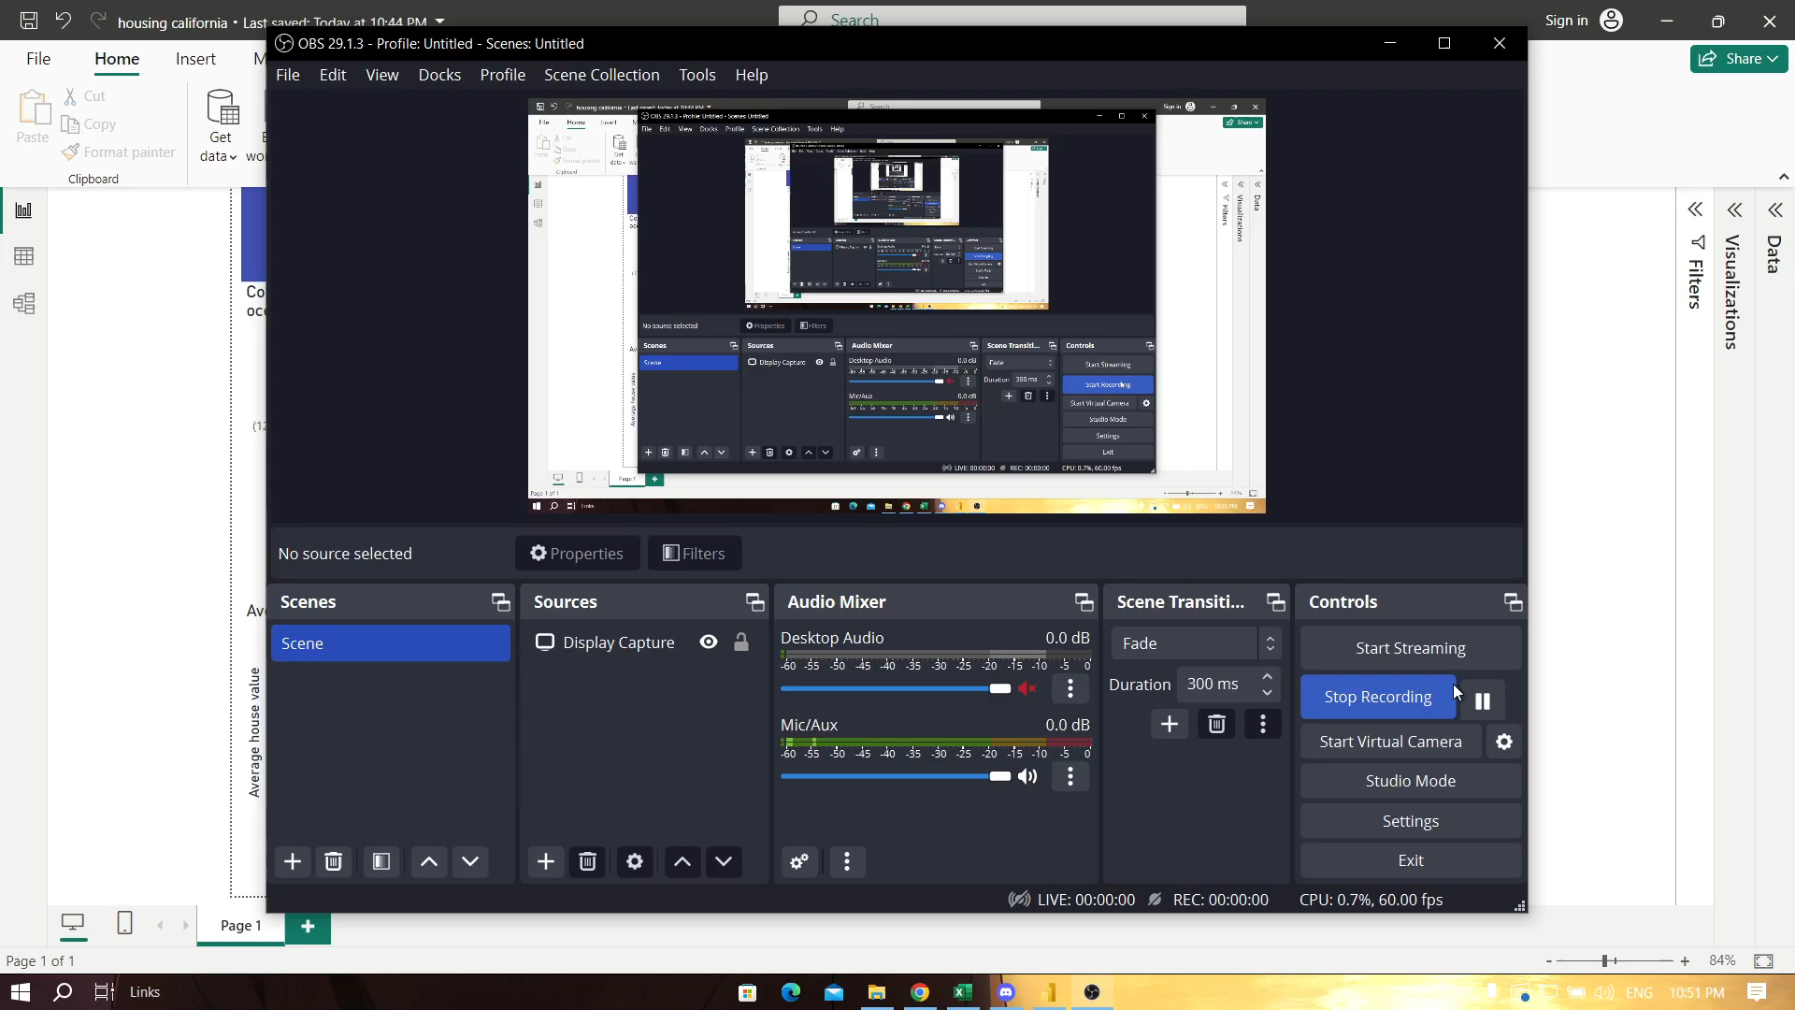
Housing price data Video explination

Slide 19
Thanks
Do you have any questions?
Name | ID
Mahmoud Essam Fathy | 20221460231
Abdelrahman Ashraf | 20221374041
Abdallah Hussein | 20221427861
Zyad Ashraf Hafez | 20221374025
Fares Mohamed | 20221461330

